Slide 1
Modern Buildable Projects with IBM i Project Explorer and Bob
Edmund Reinhardt, IBM Product Architect - IBM i App Dev & AI Solutions for IBM i edmund.reinhardt@ca.ibm.com
Sanjula Ganepola, IBM
Software Developer – IBM I App Dev & AI Toolchain
Sanjula.Ganepola@ibm.com

Slide 2
Agenda
Challenges with Building on IBM i
How does local development overcome this?
What are IBM i Projects?
What is Bob and how to use it?
Ins and Outs of IBM i Project Explorer

Slide 3
Challenges with Building on IBM i

Slide 4




Building on IBM i is limiting…
SRC-PF
10 char names
Fixed record length
Not accessible to open ecosystem, including Git and Make
Source of the same type stored in QxxxSRC to avoid name conflicts (member type does not disambiguate)
Libraries
Only 2 level hierarchy to organize, with only short 10 char names
Source control
None (sequence number dates)
Home grown
Proprietary IBM i systems
Cost
Smaller market = less investment
Build system
Individual CRTXXXMOD + CRTPGM
CL Scripts
A couple of vendors have dependency-based build

Slide 5
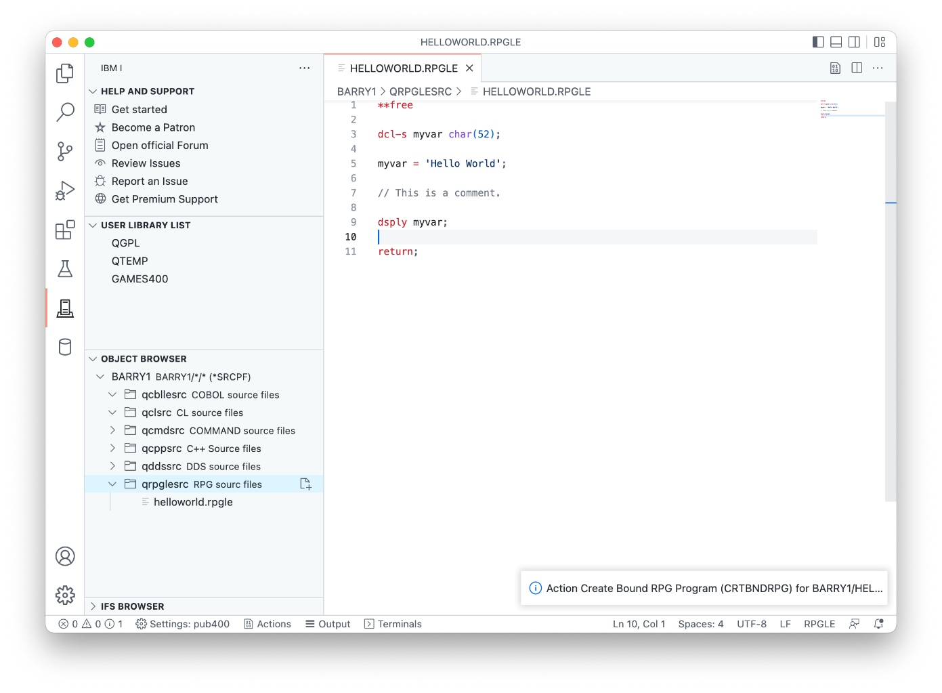
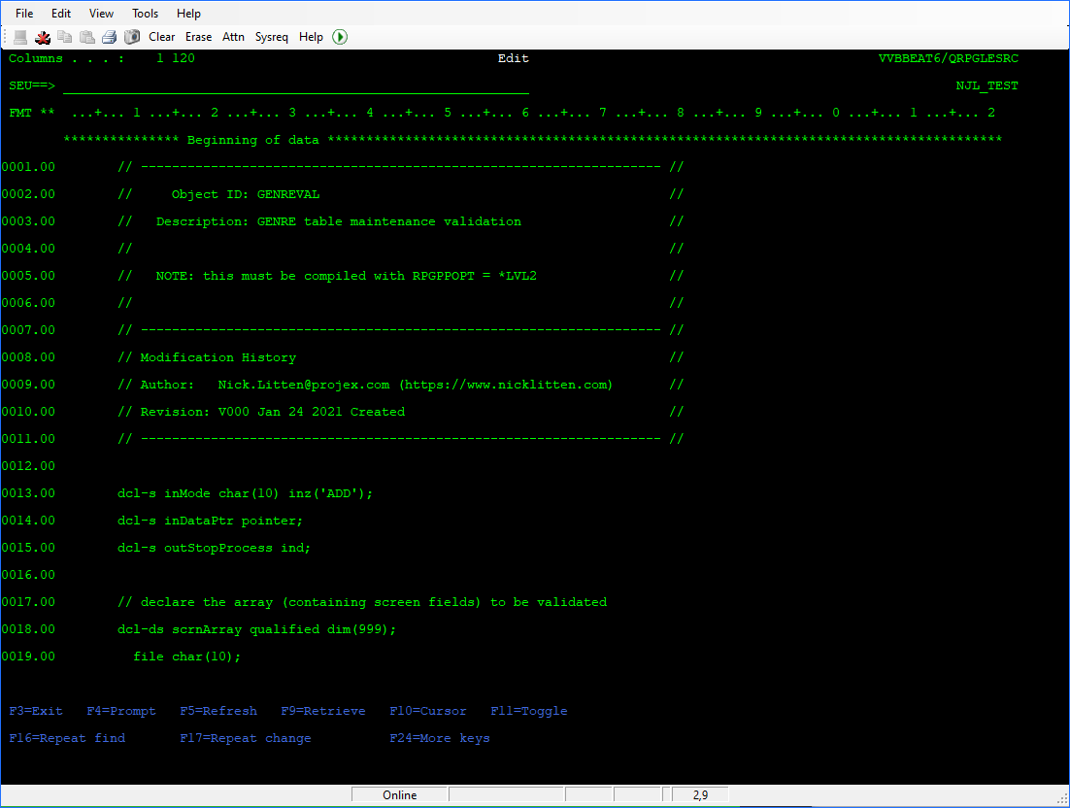
Let’s look ahead to the future
Need for Modernization is Urgent
New development tools/ecosystems
(ie. Code for IBM i/Merlin)
Modern development practices (ie. Git)
New Developers Incoming!

Slide 6
How does local development overcome this?

Slide 7
Let's use a different (but similar) file system
MYPROJECT
QRPGLESRC
CUSTOMER.RPGLE
INVENTORY.RPGLE
STARTJOB.RPGLE
QSQLSRC
CUSTOMERS.SQL
INVENTORY.SQL
QCLLESRC
START.CLLE
QCMDSRC
STARTJOB.CMD
/my-project
/.git
qrpglesrc
customer.rpgle
inventory.rpgle
startjob.rpgle
qsqlsrc
customer.table
inventory.table
qcllesrc
start.clle
qcmdsrc
startjob.cmd
No more character name restrictions
Now usable with Git and Make
QSYS.LIB Library
IFS/Local File System

Slide 8
Let’s go one step further!
/my-project
/.git
qrpglesrc
customer.rpgle
inventory.rpgle
startjob.rpgle
qsqlsrc
customer.table
inventory.table
qcllesrc
start.clle
qcmdsrc
startjob.cmd
/my-project
/.git
customer-management
customer.rpgle
customer.table
inventory-service
inventory.rpgle
inventory.table
start-command
startjob.pgm.rpgle
start.clle
startjob.cmd
Flexible directory structure
IFS/Local File System
Logical Organization

Slide 9






Unlocking source control with Git
Distributed Development
Version Control and Git Workflow
master
Remote Git Repo (GitHub, GitLab, Azure, BitBucket, etc.)
release
feature/new-input
bug/broken-logic
Developer A
Developer B

Slide 10


Did we solve our problems?
SRC-PF
10 char names
Fixed record length
Not accessible to open ecosystem, including Git and Make
Source of the same type stored in QxxxSRC to avoid name conflicts (member type does not disambiguate)
Libraries
Only 2 level hierarchy to organize, with only short 10 char names
Source control
None (sequence number dates)
Home grown
Proprietary IBM i systems
Cost
Smaller market = less investment
Build system
Individual CRTXXXMOD + CRTPGM
CL Scripts
A couple of vendors have dependency-based build

Slide 11
What are IBM i Projects?

Slide 12


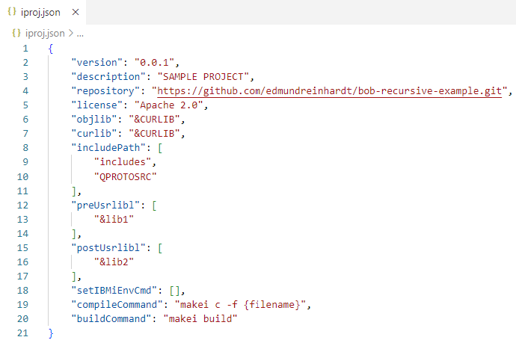
Projects that self-describe how to build themselves!?
my-project
.evfevent
file.evfevent
source.evfevent
.logs
Project Information
joblog.json
file.splf
Standardized metadata format with variables (&…)
source.splf
includes
constants.rpgleinc
QRPGLESRC
Configure library list
.ibmi.json
Rules.mk
source.rpgle
Set build/compile command
QDDSSRC
Rules.mk
file.pf
Configure build/compile environment
.env
.gitignore
.ibmi.json
iproj.json in project root
iproj.json
Rules.mk

Slide 13
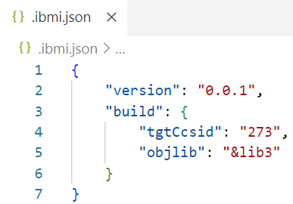
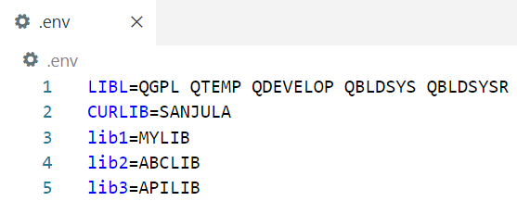
Flexible subdirectories and build customization
my-project
.evfevent
file.evfevent
EBCDIC encoding for compiler
source.evfevent
.logs
joblog.json
file.splf
source.splf
Target object library for directory
includes
constants.rpgleinc
QRPGLESRC
.ibmi.json in project root or subdirectories
.ibmi.json
Rules.mk
source.rpgle
QDDSSRC
Rules.mk
Custom variable values so that each developer can customize build
file.pf
.env
.gitignore
.ibmi.json
iproj.json
.env in project root
Rules.mk

Slide 14
What is Bob and how to use it?

Slide 15
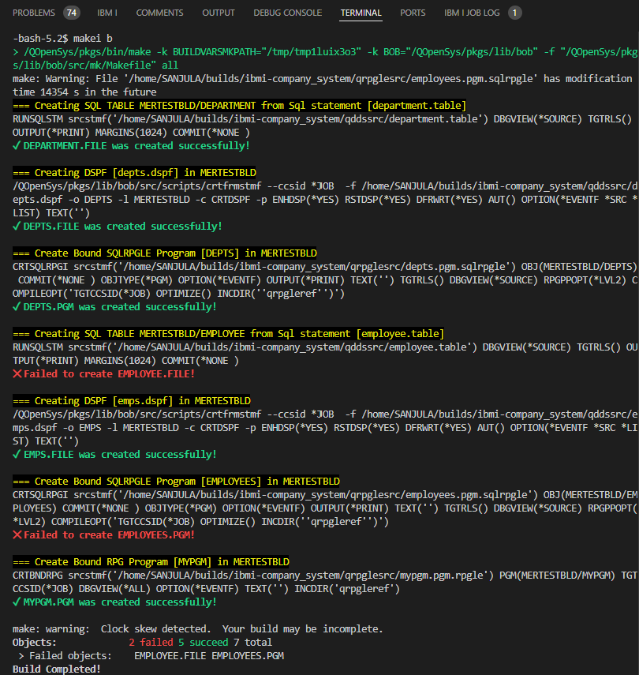
What is Bob?
Free and open-source build system to build QSYS objects on IBM i
🚀 Speed: Compile objects that need recompiling (new or changed source code)
🛠 Reliability: If an item changes, then it and everything it depending on it will be rebuilt
💎 Industry standard: Object dependencies are specified using standard makefile syntax
🔧 Flexibility: Override compile parameters, write custom recipes (If you can code it, you can build it!)
🌟 Ease of use: Build with a single command or a single button in an IDE (IBM i Project Explorer in VS Code)

Slide 16
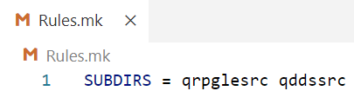
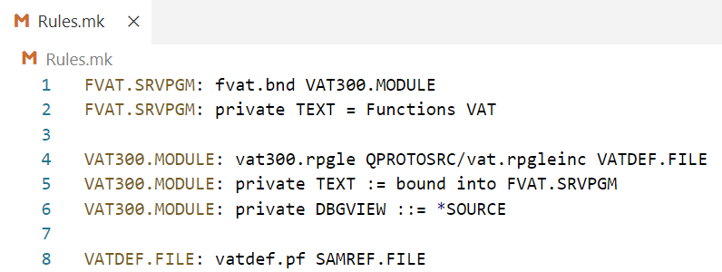
Defining targets with Rules.mk
my-project
.evfevent
file.evfevent
source.evfevent
.logs
Declare subdirectories to be built
joblog.json
file.splf
source.splf
Rules.mk in project root
includes
constants.rpgleinc
QRPGLESRC
.ibmi.json
Rules.mk
source.rpgle
QDDSSRC
Makefile with list of objects to be built and from which source files
Rules.mk
file.pf
.env
.gitignore
.ibmi.json
iproj.json
Rules.mk in subdirectories
Rules.mk

Slide 17
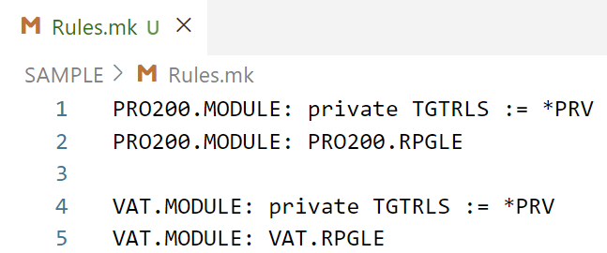
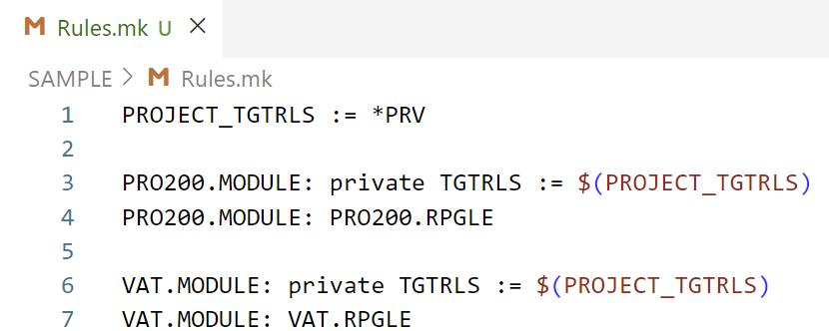
Variables in Rules.mk
Declare variables to override compile settings for multiple targets

Slide 18
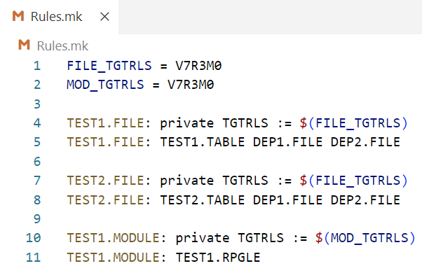
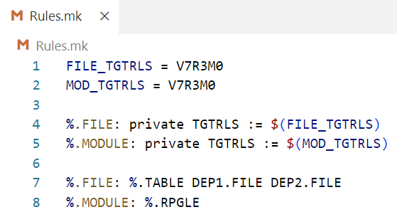
Wildcarding in Rules.mk
Use wildcarding when you have files that create objects of the same type

Slide 19
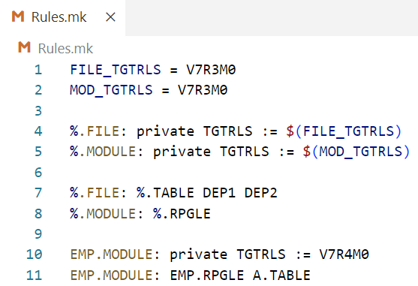
Overriding Wildcards in Rules.mk
Explicitly defined compile options take precedence over wildcarding

Slide 20
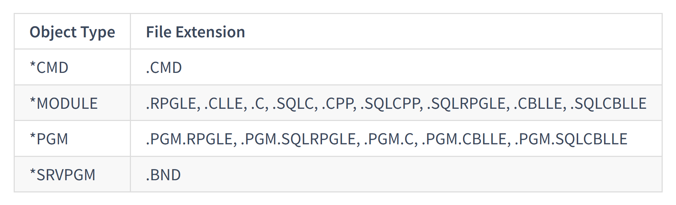
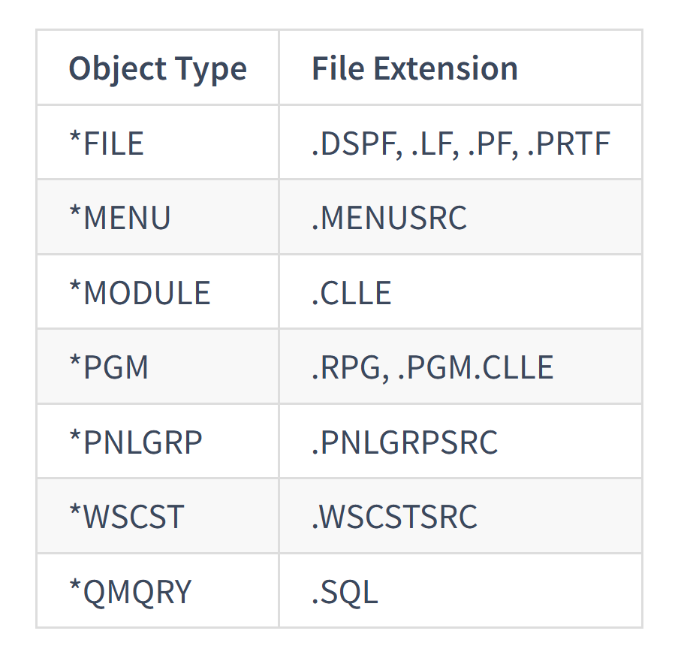
Supported Object Types
These older IBM i source types can be compiled as well (CRTFRMSTMF copies the source to QTEMP/QSOURCE before compiling)
These IBM i source types can be compiled directly from the IFS …

Slide 21
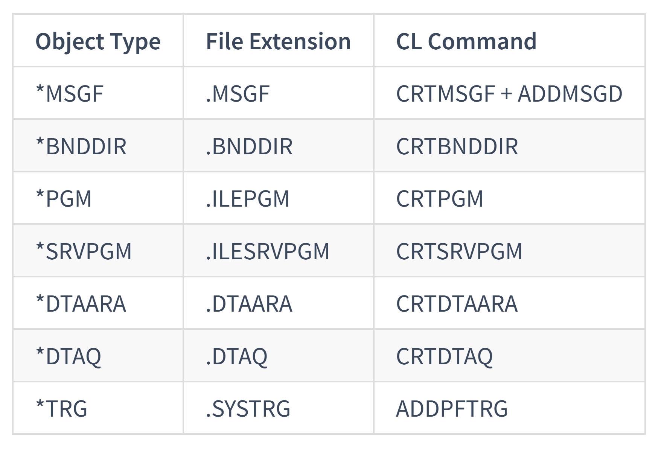
CL pseudo-source
The CL command to create these object types are stored in a file with the given extension …

Slide 22
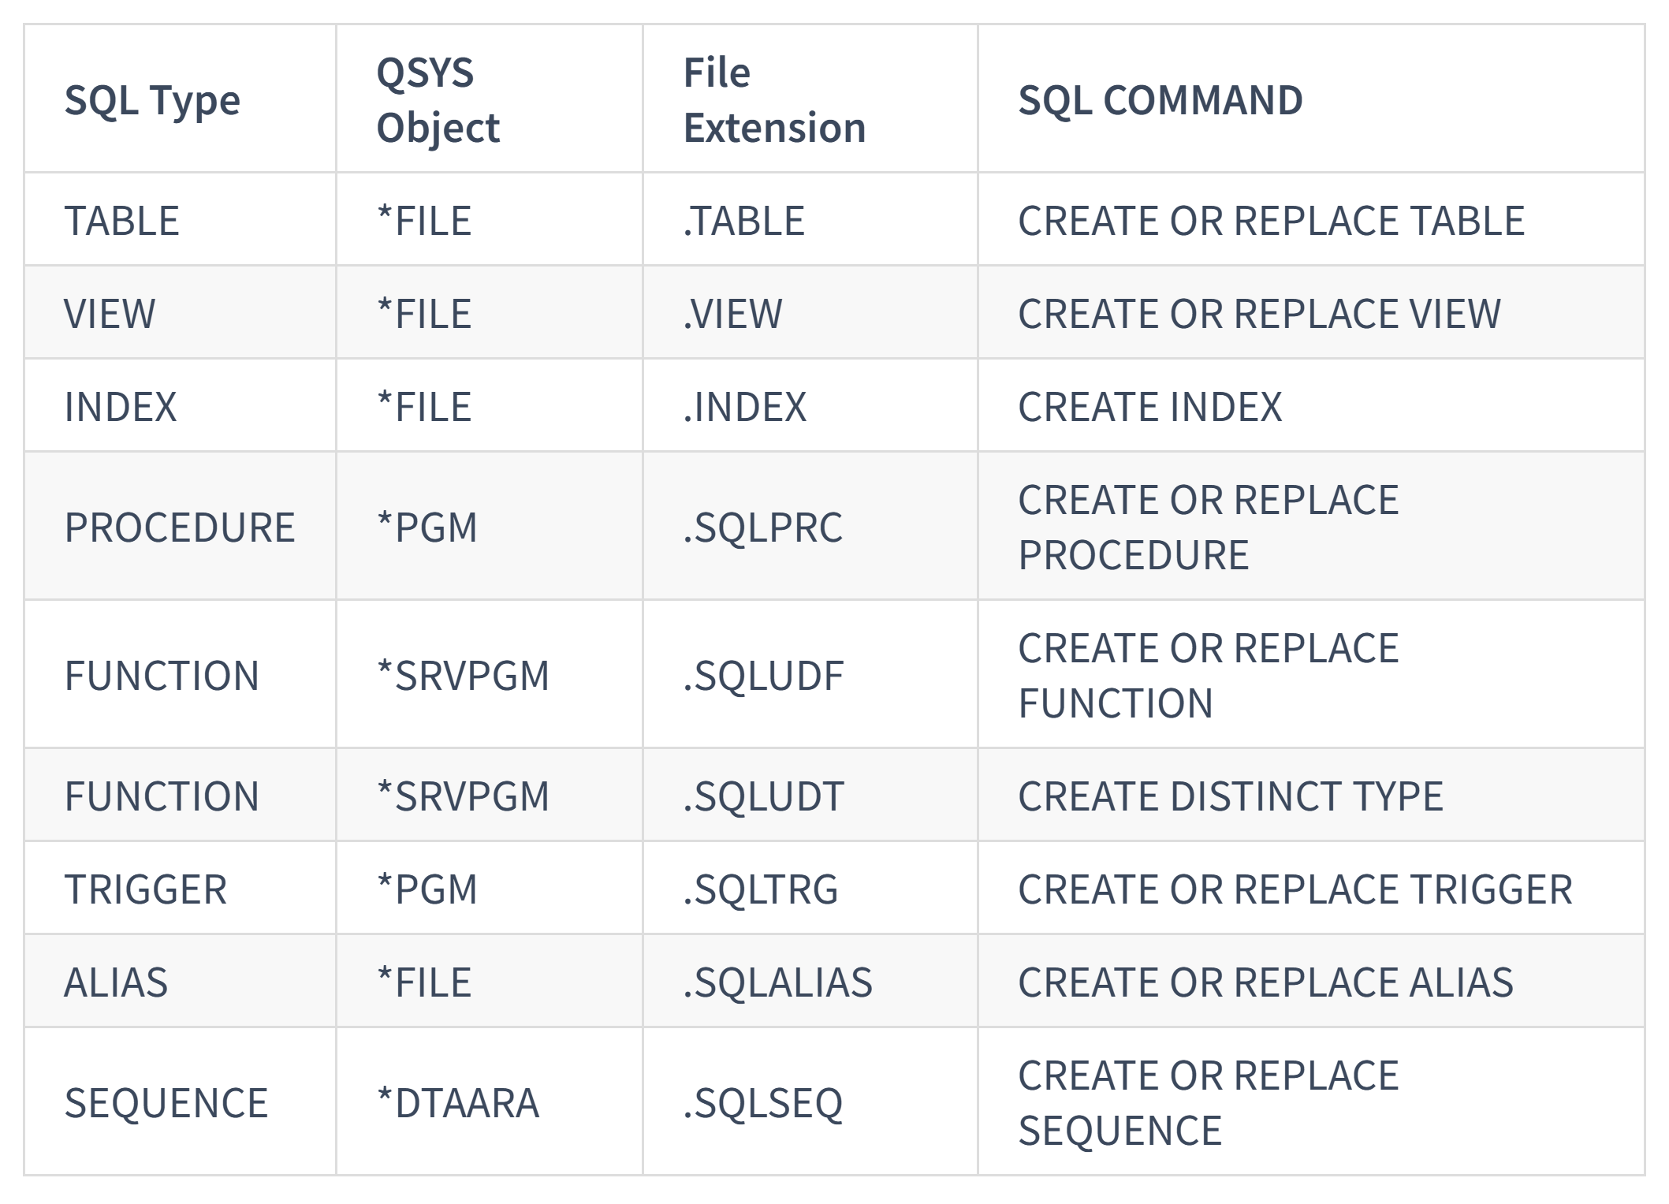
SQL pseudo-source
The SQL command to create these object types are stored in a file with the given extension and are created via RUNSQLSTM …

Slide 23
Build and Compile Process
Initialization and Migration
Command | Description
makei init | Create iproj.json
makei cvtsrcpf | Convert QSYS members to Unicode IFS stream files
Building
Command | Description
makei build | Build the entire project
makei b –t <object> | Build target object
makei b –d <directory> | Build all objects in the specified directory (based on Rules.mk)
Compiling
Command | Description
makei compile -f <stream file> | Compile target object of specified stream file
makei compile –files file1: file2: … | Compile target objects of all specified stream files

Slide 24
Ins and Outs of IBM i Project Explorer

Slide 25
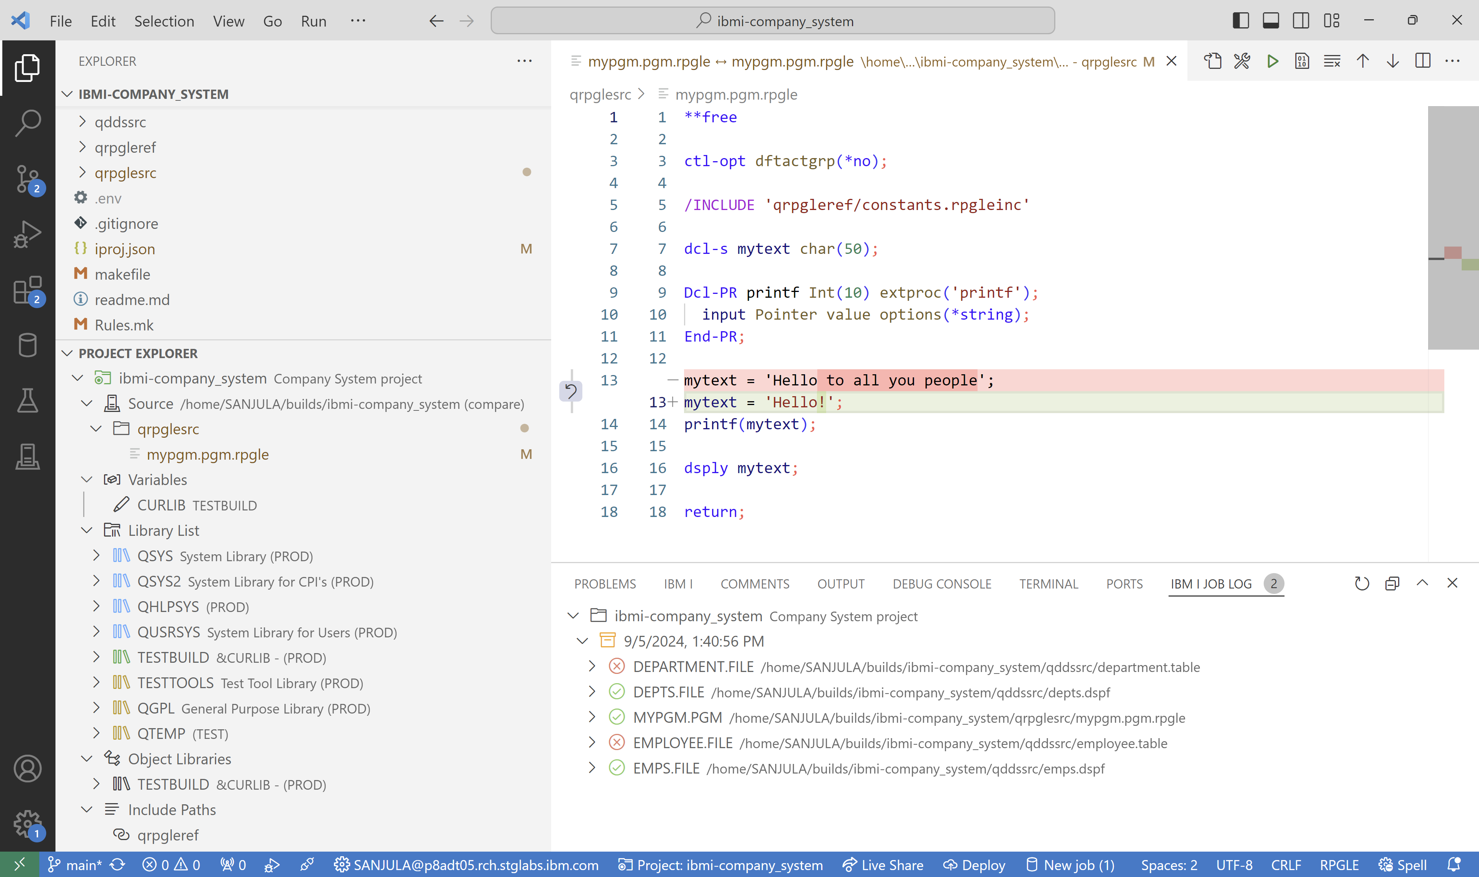
Overview
The ultimate tool for local development on IBM i!
Set variables
Build and Compile
Local source vs. IFS source
Manage library list
Modify include paths
View job logs

Slide 26
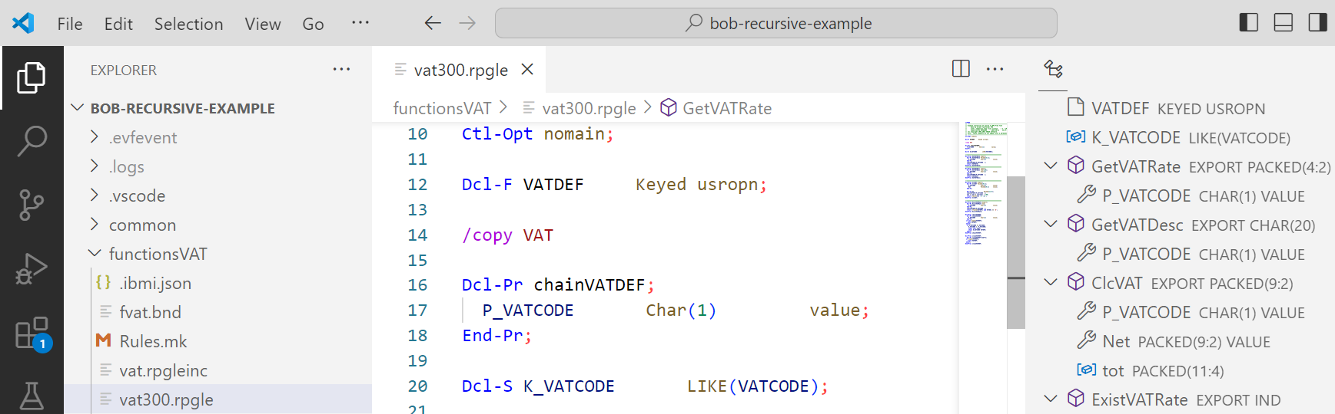
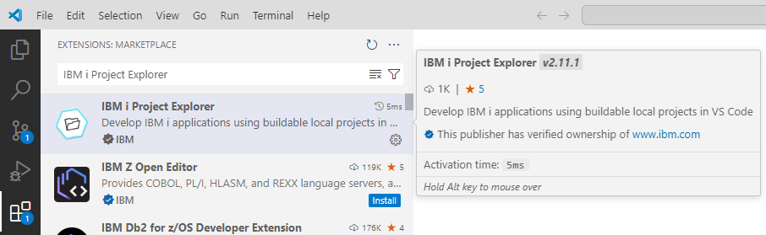
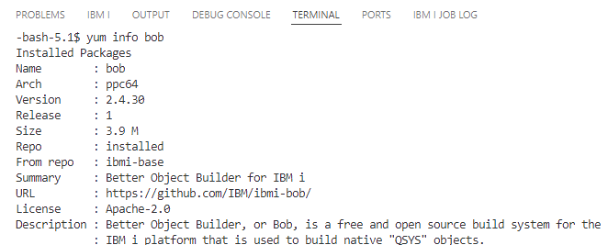
Installation
Download
Visual Studio Code
Download VS Code extensions
IBM i Project Explorer, Source Orbit and Code for IBM i or just the IBM i Development Pack
Run
yum install bob
on IBM i

Slide 27
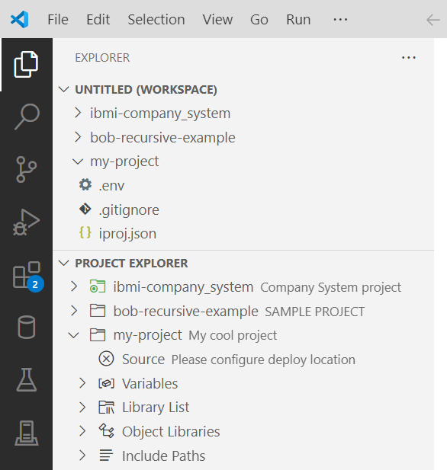
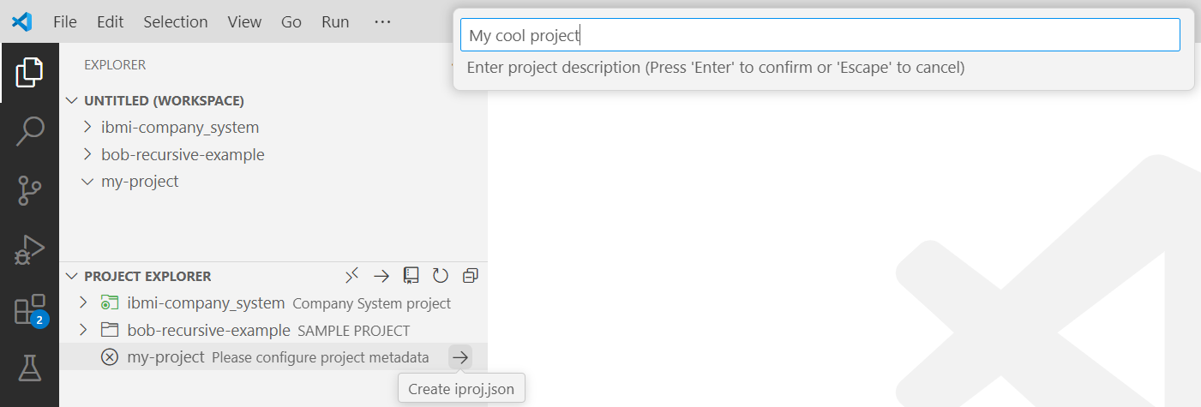
Create a New Project
Create and open a folder for your project
Create an iproj.json
Set the project description

Slide 28
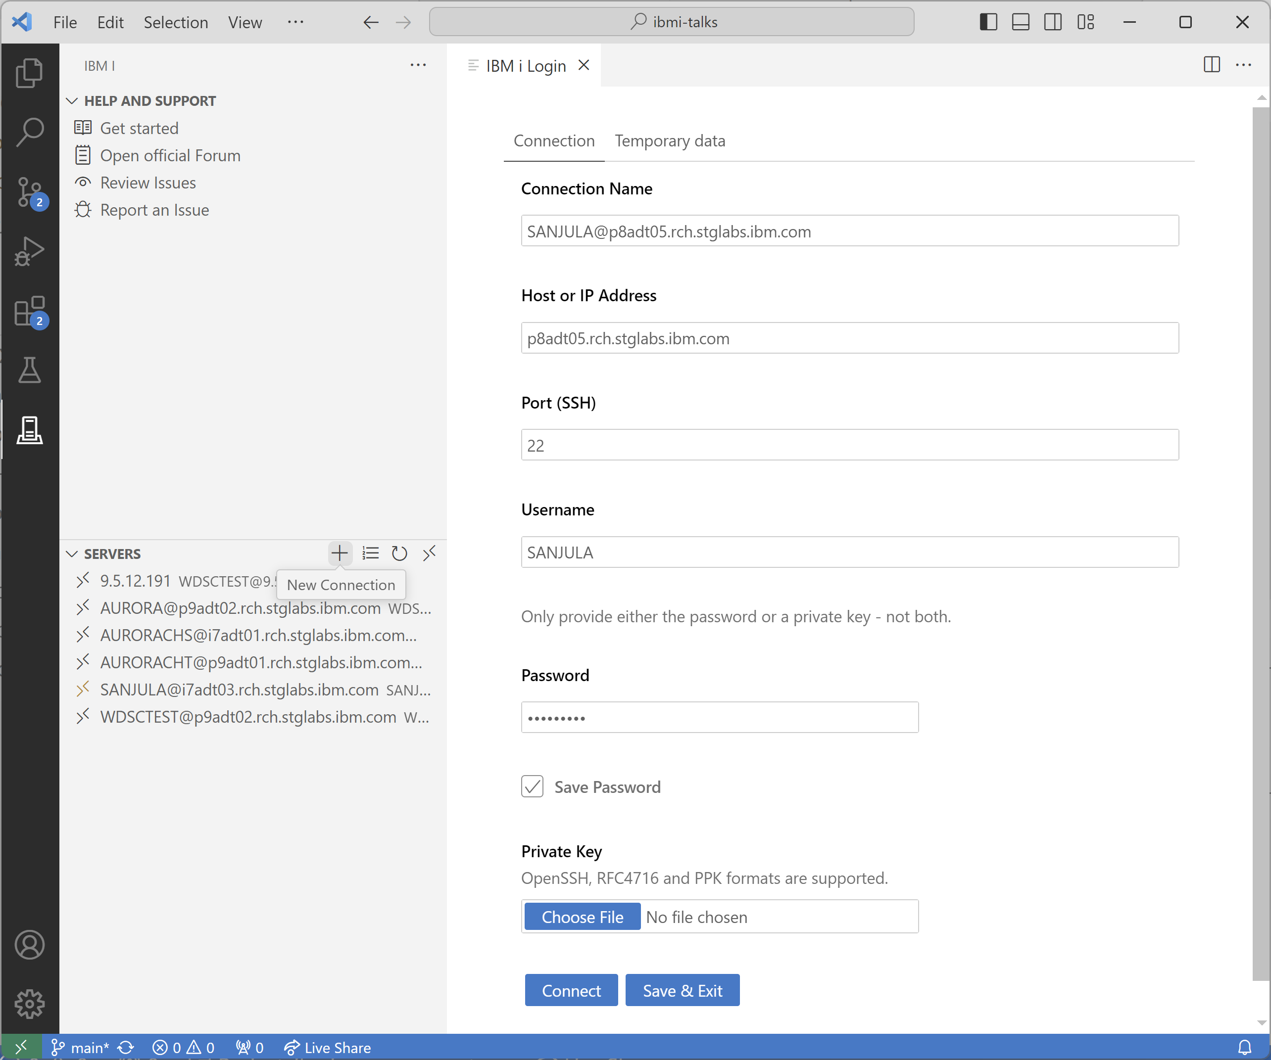
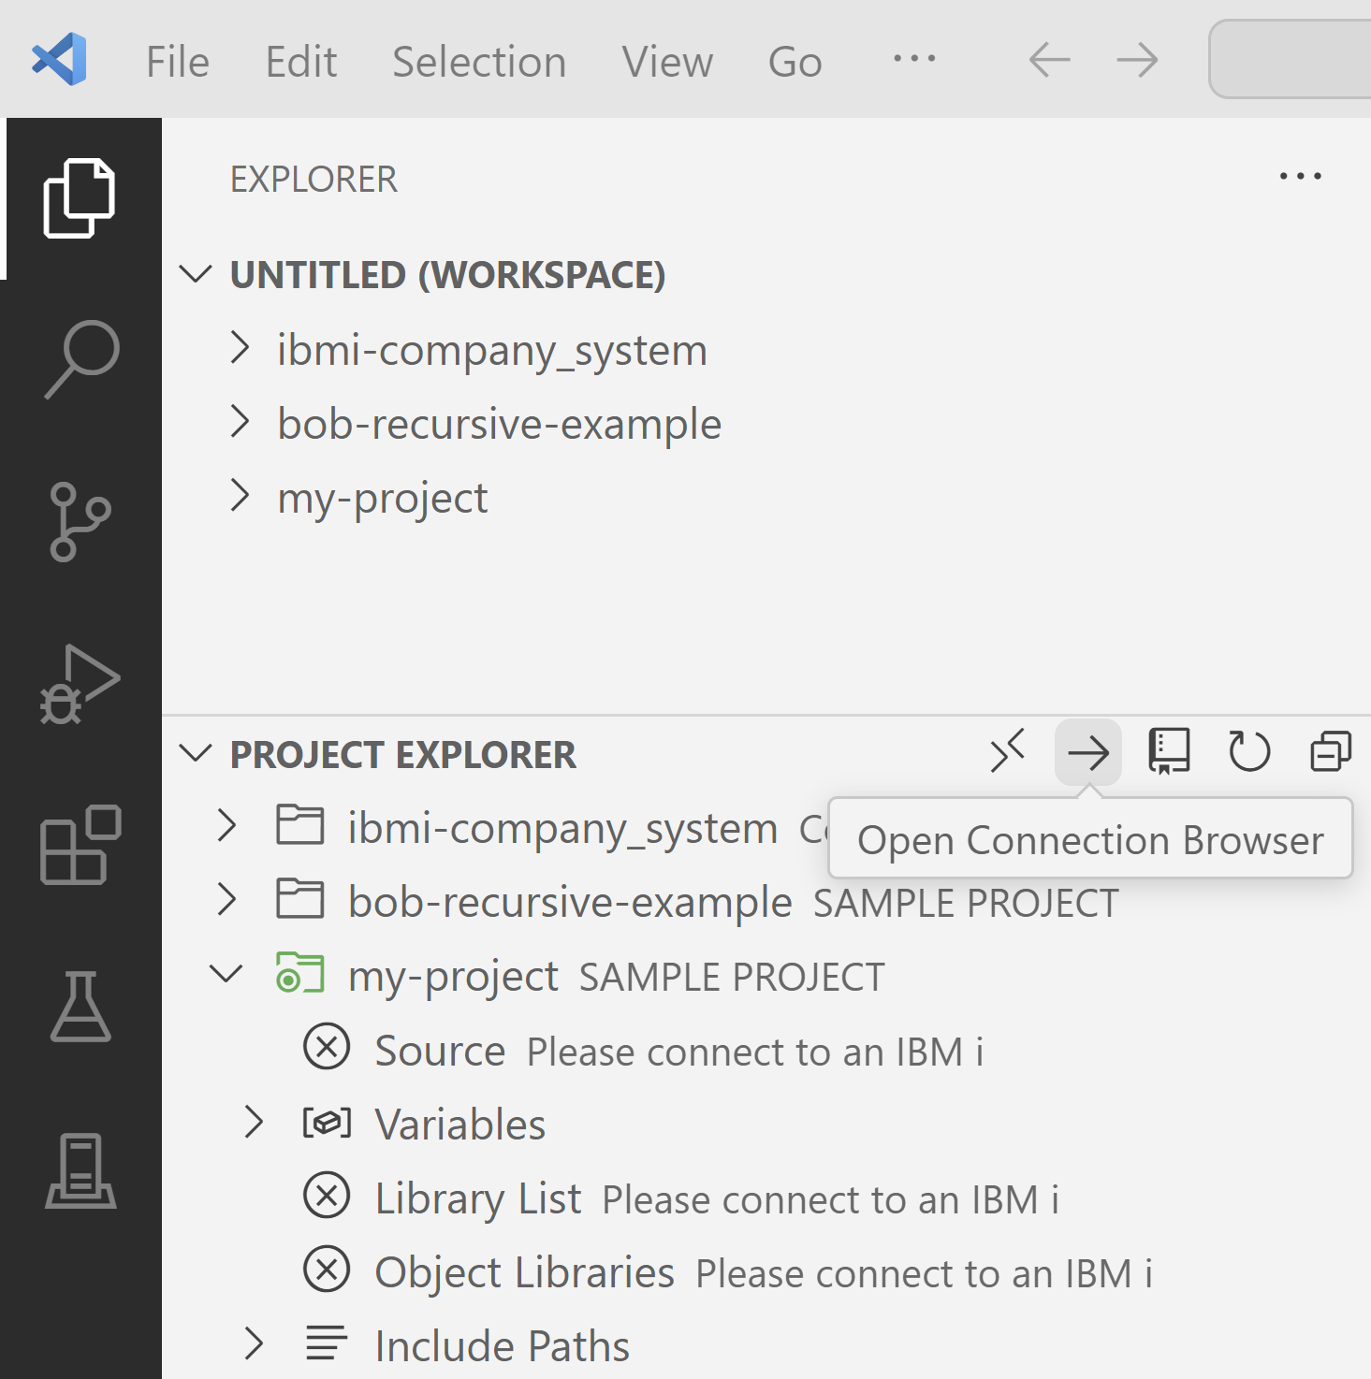
Connect to an IBM i
Open the Connection Browser from Project Explorer
Create new IBM i connection from the Server view

Slide 29
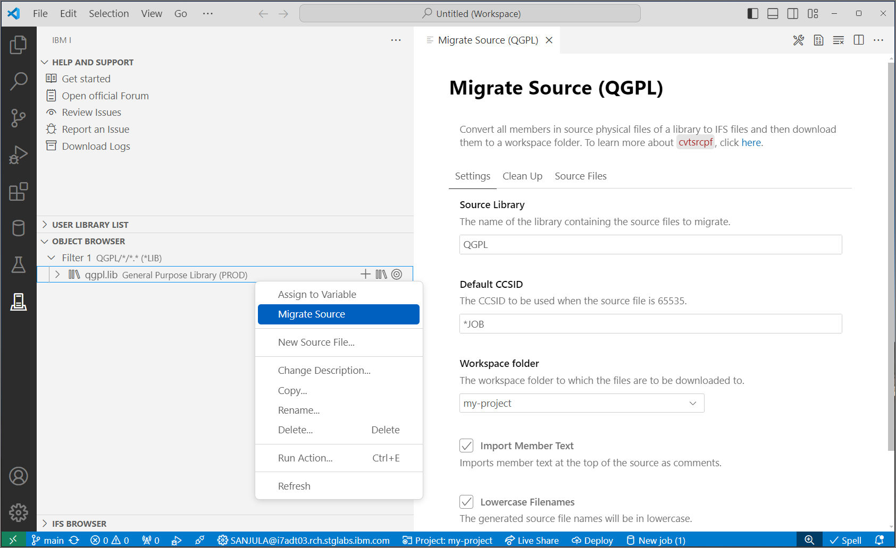


Migrate Source from QSYS
QSYS members in source physical files
↓
Properly encoded, terminated, and named source files in an IFS directory
↓
Download to local project
↓
Rename extensions
↓
Convert includes/copy directives to Unix style paths
CVTSRCPF from BOB
Source Orbit

Slide 30

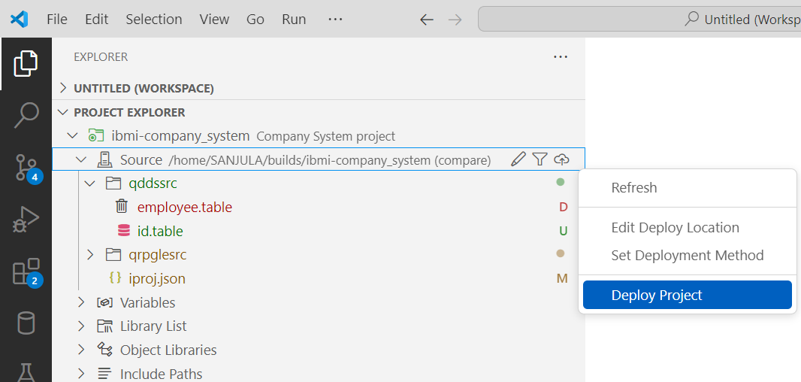
Deployment
Set deploy location
Where source gets uploaded to
Typically set one
Each developer gets a unique location
Each repository gets a unique location
Set deployment method
Compare (typically the safest)
Changes (typically the fastest)
Working Changes
Staged Changes
All
Deploy project
Moves files to deploy location based on deployment method
Deploy
Build
Local Project
IFS Directory
Target Library

Slide 31
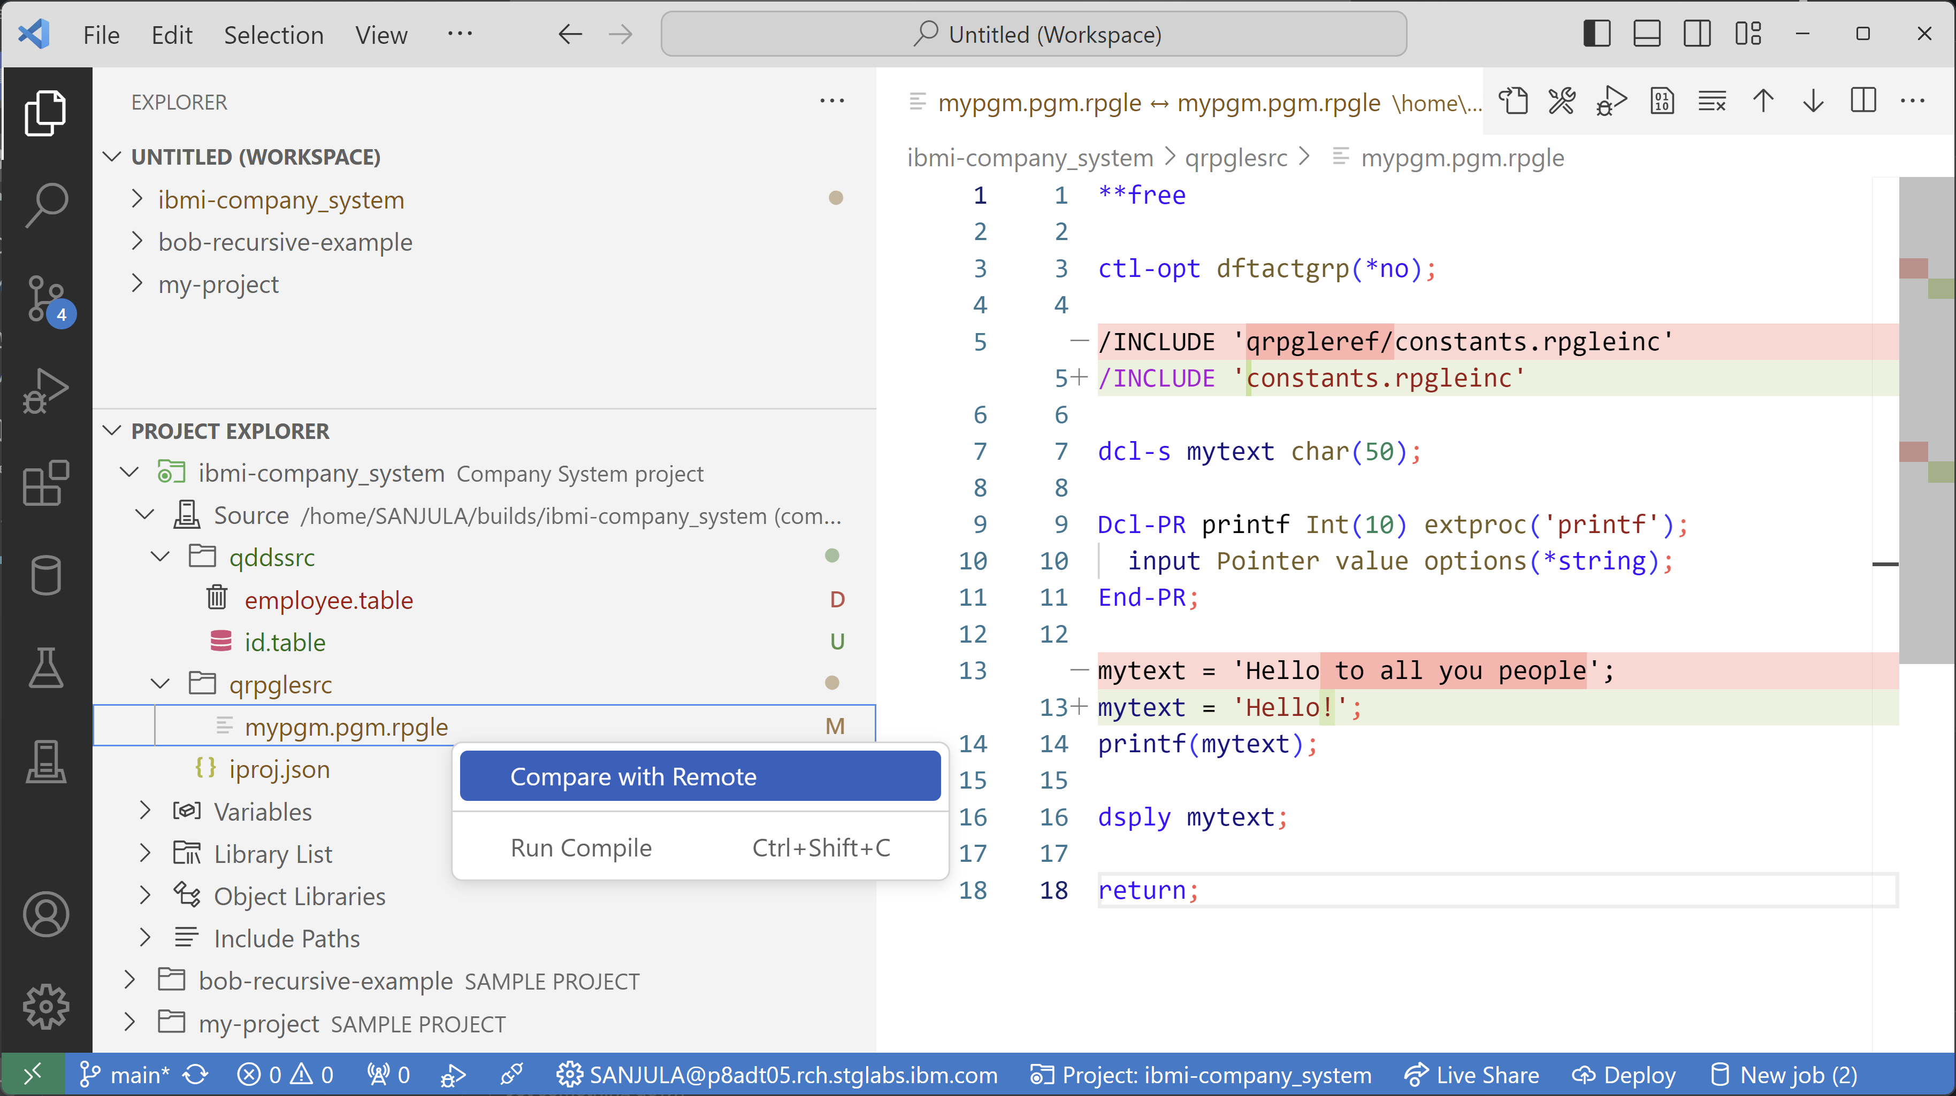
Visualize Local vs. Remote Source Files
Visualize, compare, and deploy your local source files to the deploy location in the IFS
Track file changes (added, modified, deleted, etc.)
Compare local file content with remote IFS

Slide 32
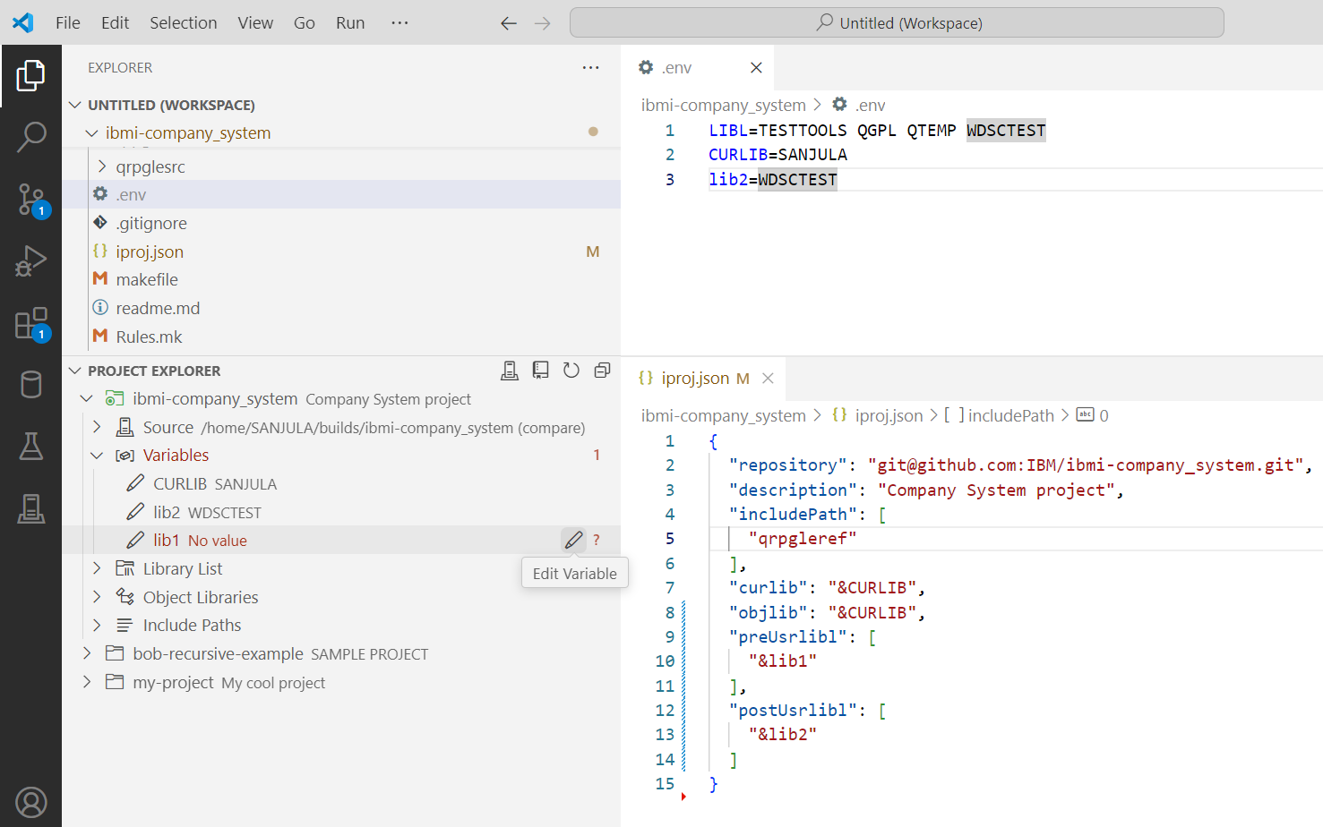
Work with Variables
Reusable project definition that can be used by multiple developers or in automated builds
View and set variables (for libraries, include paths, or build/compile commands)
Browse for libraries and assign values to variables
Configure hardcoded values as variables
Do not push .env file to Git!

Slide 33
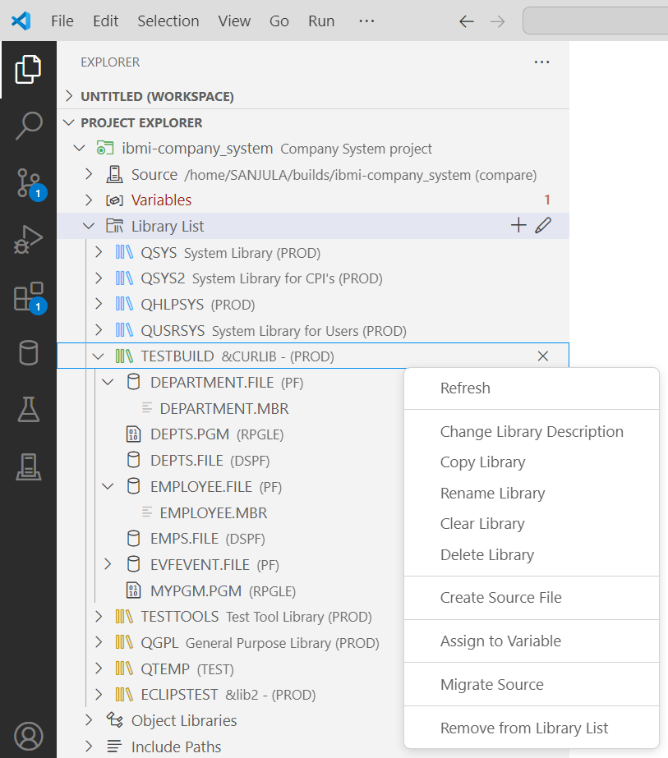
Manage the Library List
Project’s library list is a composition of your user profile’s library list (from JOBD) + set of project specific libraries
Add to beginning/end of library list (preUsrlibl and postUsrlibl) and set current library (curlib in iproj.json)
Reorder library list
Browse objects and members
Manage libraries, objects, and members

Slide 34
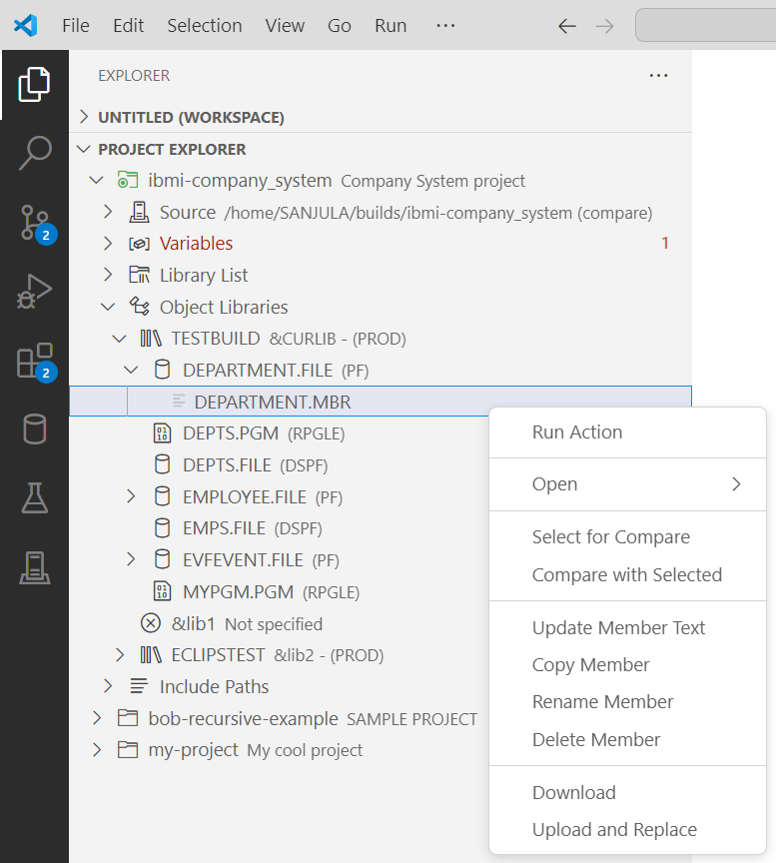
Browse Object Libraries
The place for developers to easily see, debug, and manipulate the results of your build
Another place to manage libraries in iproj.json (curlib, objlib, preUsrlibl, postUsrlibl)
Manage libraries, objects, and members

Slide 35
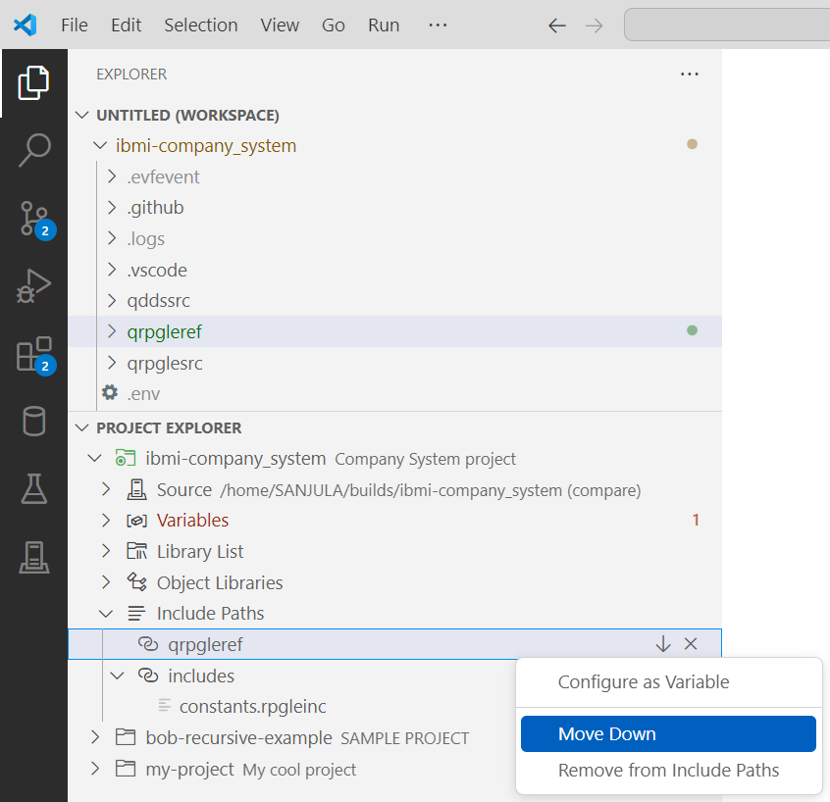
Manage Include Paths
Self-contained projects should know where to find includes within the project
Add, remove, and reorder include paths
Visualize if includes resolve locally or to remote IFS

Slide 36
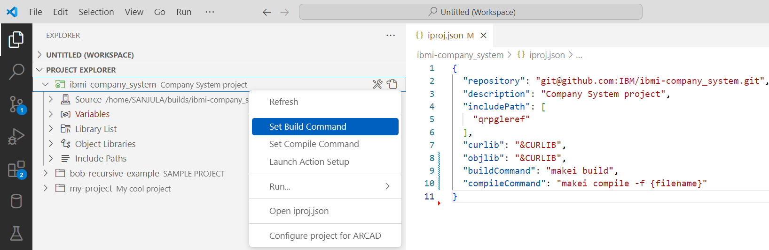
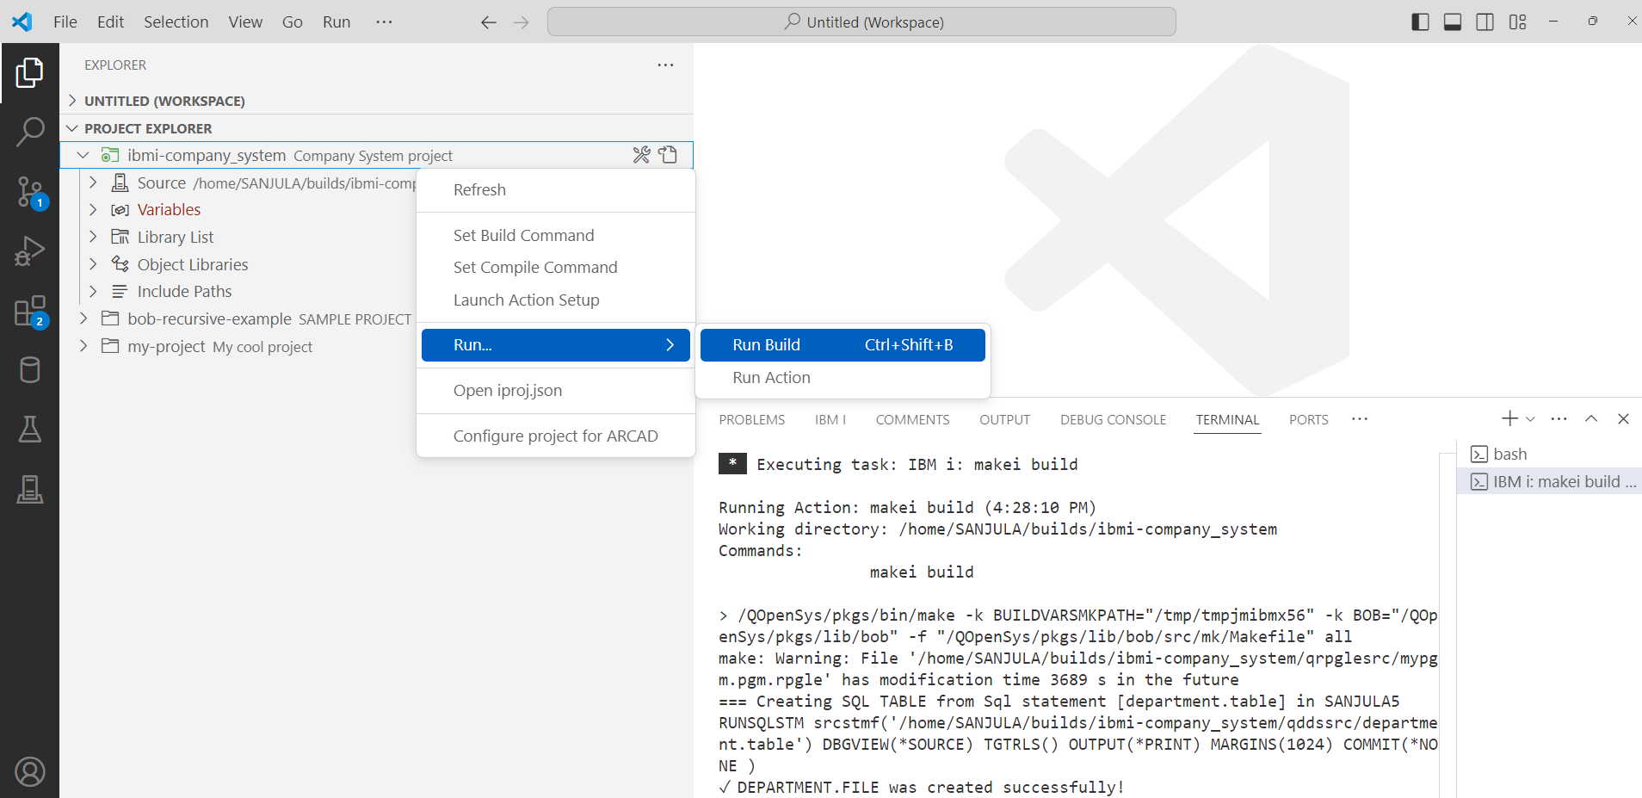
Build and Compile
Deploy
↓
Run build or compile command
(any build framework)
↓
Download logs and evfevent files
Building
Set build command
Run Build (Ctrl+Shift+b or Cmd+Shift+b)
Compiling
Set compile command
Run compile (Ctrl+Shift+c or Cmd+Shift+c)
On active editor
On file or directory in File Explorer
On file or directory in Source

Slide 37
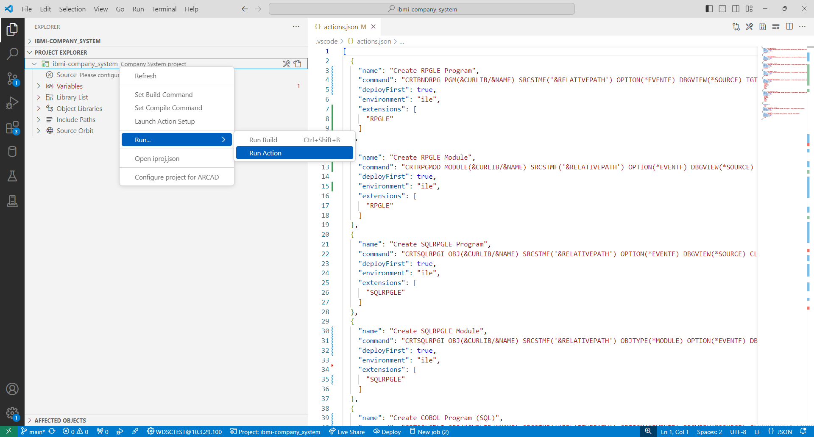
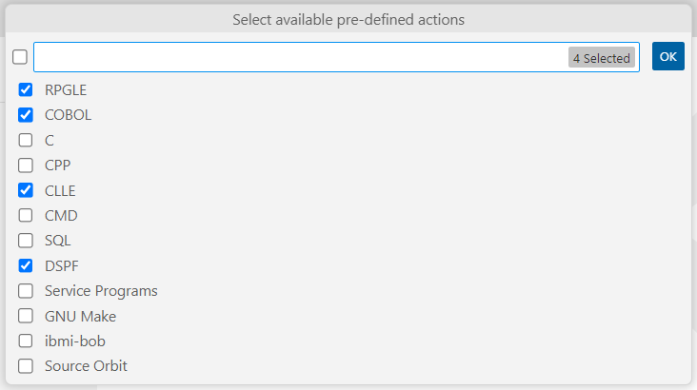
Run Actions
IBM i Project Explorer also supports running Code for IBM i’s custom workspace actions

Slide 38
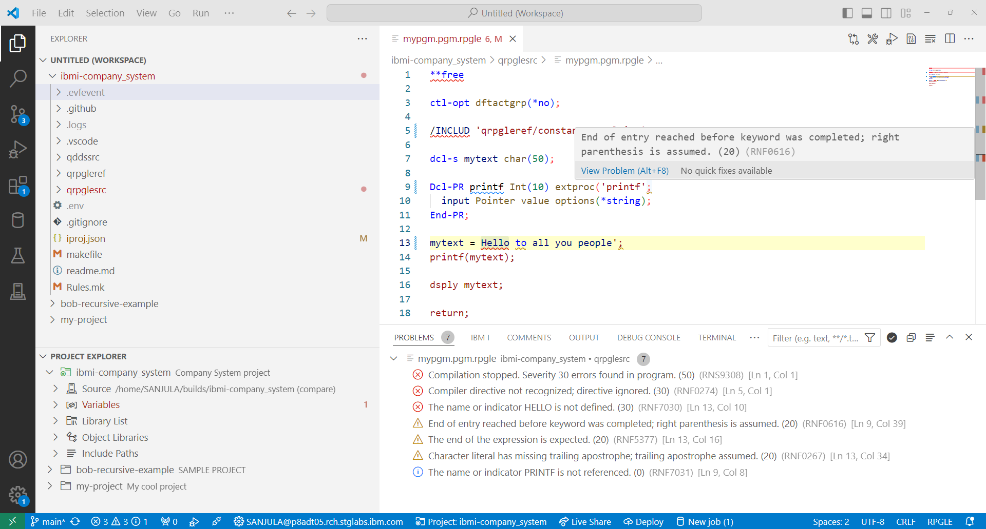
View Diagnostics
Visualize build or compile diagnostics in the Problems view
Evfevent file diagnostics are dumped in a .evfevent directory after a build or compile
Diagnostics are also rendered inline in the source file

Slide 39
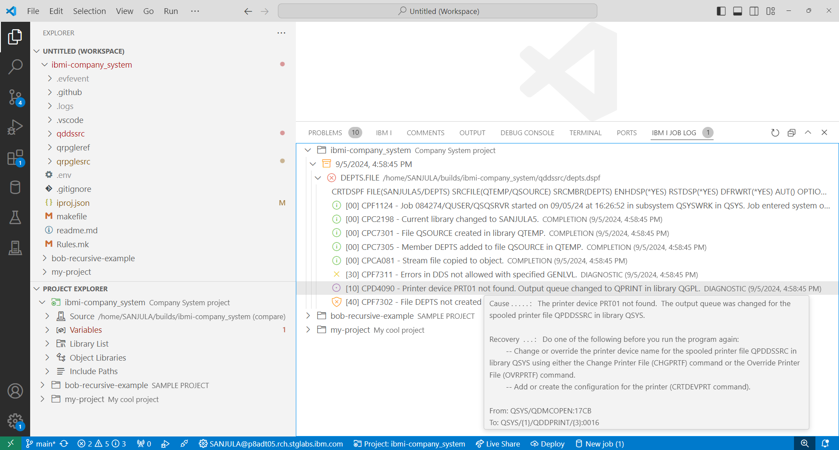
View Job Logs
Visualize and manage anything that could be seen in an IBM i job log including second level help
Job log and spool files are dumped in .logs directory after a build or compile
Track up to 10 of the previous logs in memory
Organized by the ILE objects being built
Filter by failed objects or severity

Slide 40

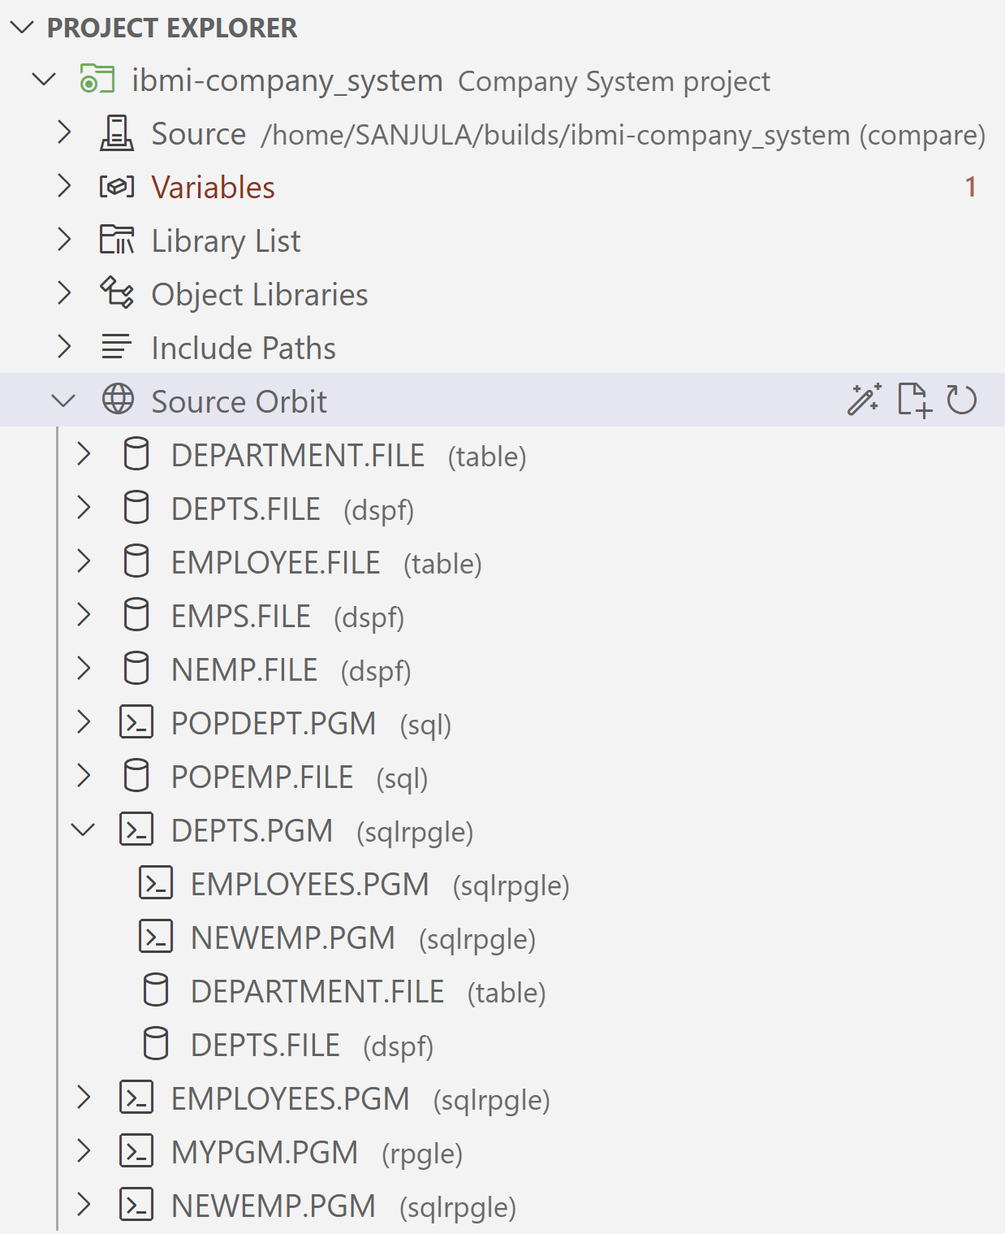
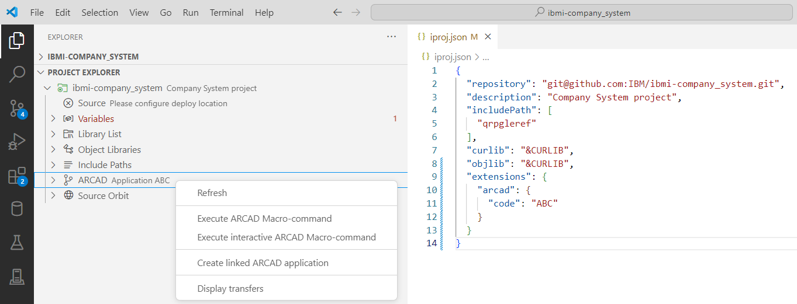
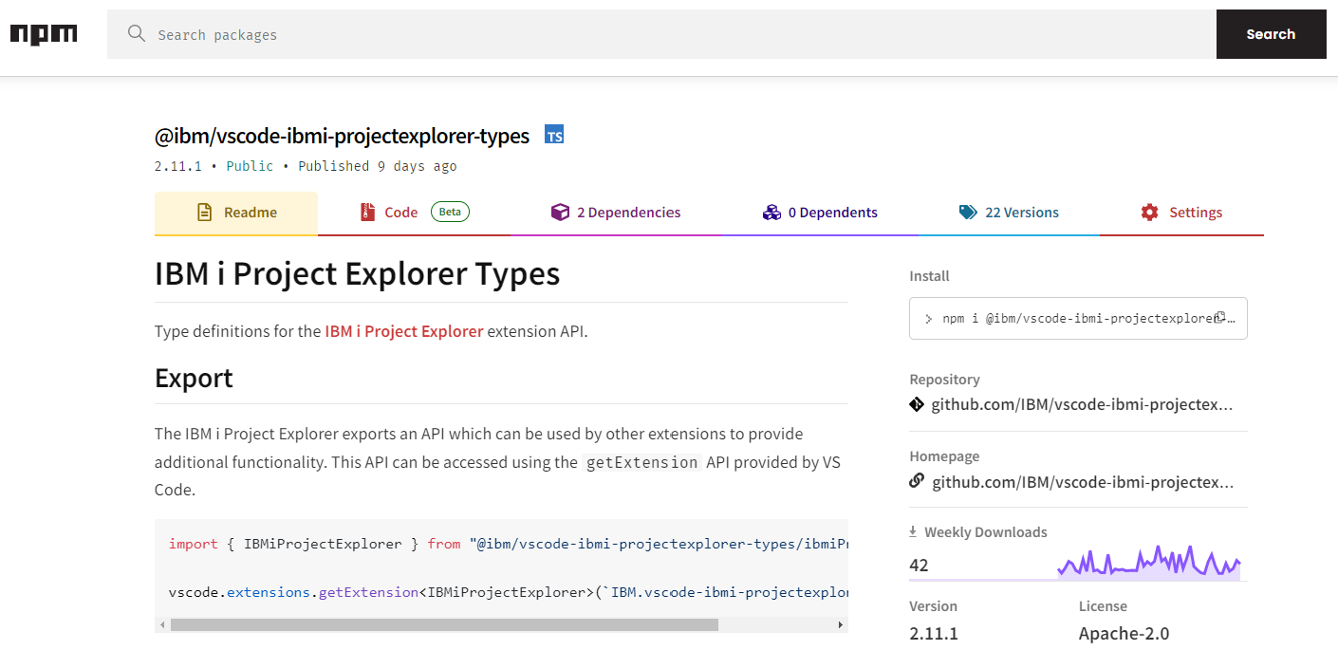
Integration
Source Orbit
ARCAD-Elias
What can you integrate with IBM i Project Explorer’s API?

Slide 41
Any Questions?

Slide 42
Important Links
IBM i Project Explorer
VS Code Marketplace https://marketplace.visualstudio.com/items?itemName=IBM.vscode-ibmi-projectexplorer
Documentation https://ibm.github.io/vscode-ibmi-projectexplorer/#/
GitHub Repository https://github.com/IBM/vscode-ibmi-projectexplorer
API https://www.npmjs.com/package/@ibm/vscode-ibmi-projectexplorer-types
Bob
Documentation https://ibm.github.io/ibmi-bob/#/
GitHub Repository https://github.com/IBM/ibmi-bob
Code for IBM i
VS Code Marketplace https://marketplace.visualstudio.com/items?itemName=HalcyonTechLtd.code-for-ibmi
Documentation https://codefori.github.io/docs/#/
GitHub Repository https://github.com/codefori/vscode-ibmi
API https://www.npmjs.com/package/@halcyontech/vscode-ibmi-types

